Slide 1
CS Unit Kick-off

Slide 2






HELLO!
• My name’s Mari
• Software Engineer for 6 years
• Currently a Sr. iOS Engineer in FB Dating
• Previously at Apple, Coursera
• I love EDM, boxing & photography

Slide 3
AGENDA
• CS Unit Expectations
• Python Basics
• Attendance code will be posted in the Zoom chat during break
• Ask questions on the Slack thread
• I don’t expect you to be coding with me during lecture
• I will post slides in advance and code snippets afterwards

Slide 4
CS Unit Expectations

Slide 5
CS UNIT EXPECTATIONS
• Goal: Teach you problem solving skills, algorithms and data structures needed for technical interviews
• We’ll be using Python to learn this material

Slide 6

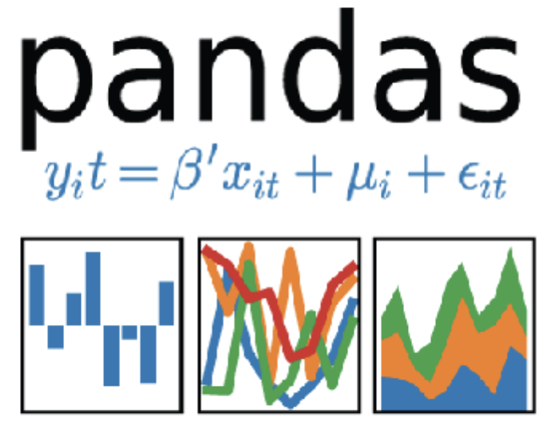

WHY PYTHON?
• Python is a very common language used in the industry
• Data analysis, server/backend frameworks (e.g. Django), scripts, etc.
• It’s also a very intuitive, readable and concise language
• Do you need to use Python for technical interviews? No!

Slide 7

ASSESSMENTS
• Module Project/Exercises
• Highly recommended to self-assess your understanding
• Sprint Challenge
• 4th Sprint Challenge: >= 60% score Required to pass the unit
• General Coding Assessment (GCA)
• Required for graduation, no minimum score required
• All these tests are done via CodeSignal
• Please use Python for these assessments
• Make sure to register using your lambda school email!

Slide 8
SUPPORT
• Our awesome SL/TLs
• Our TA, Steve Lanier, is available Mon-Fri 2:00PM - 10:00PM Lambda time
• I will be hosting AMAs throughout the unit

Slide 9
TIPS FOR SUCCESS
• CS is not easy. Do not fall behind.
• Utilize our support staff. We want you to succeed!
• Look at the warmup before lecture
• Lectures are not a substitute for material in Canvas
• Do additional problems outside of what we give you
• Leetcode is arguably the best place you can practice
• Still don’t understand? Look at other resources (Youtube, etc.)

Slide 10
Python Basics

Slide 11
PYTHON BASICS
• Python is arguably one of the easiest languages to learn!
• The following slides give a brief overview of the common things to know

Slide 12
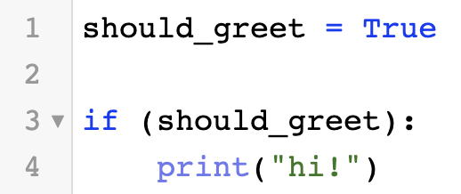
BOOLEANS
• Booleans can only have two values: True or False
• Usually used to control the flow of the program
• Commonly used operations:
• == for equality
• not keyword for negation
• bool() to cast other types to a Boolean
• Other data types can evaluate to booleans:
• e.g. “abc”, 123, [“a”, “b”] all evaluate to True
• None, 0, “”, [], () all evaluate to False
• Booleans are immutable, so they behave similar to pass-by-value when passed inside a function

Slide 13
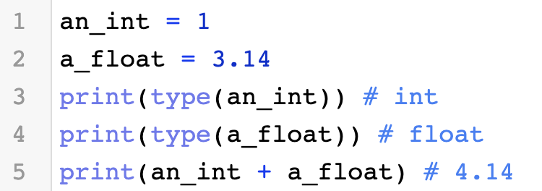
NUMBERS
• The two most common number data types: int, float
• int is a positive/negative whole number (1, 2, 3, etc.)
• float is a positive/negative number containing a decimal
• 1.0, 2.1, 3.14, etc.
• You can use math operations on these data types
• You can cast other data types to int or float
• Numbers are immutable, so if you pass them in a function, they behave similar to pass-by-value

Slide 14
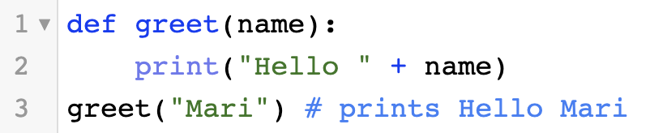
FUNCTIONS
• Defined using def keyword
• The behavior of arguments passed in a function depends on the data type
• Python cares about whitespaces to signify end-of-line and code blocks
• Fun-fact:
• Functions can contain inner functions

Slide 15
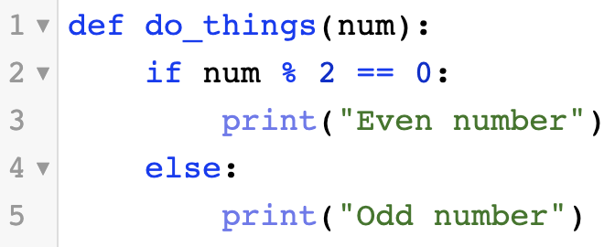
CONTROL FLOW
• You can use the following to control the flow of execution:
• if/elif/else blocks
• and/or operators
• Note: Python requires code to be indented/have whitespace in order to be executed in the block

Slide 16
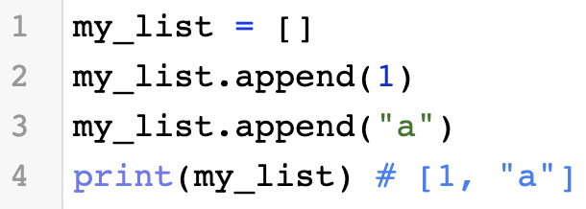
LISTS
• Implemented using arrays in Python
• Used to store sequential data
• Loosely-typed, can store heterogeneous data types
• Lists are mutable, so passing them in a function behaves similar to pass-by-reference
• Fast access via indexing and appending/removing at the end of the list
• You can get sublists using slicing
• See common operations here

Slide 17
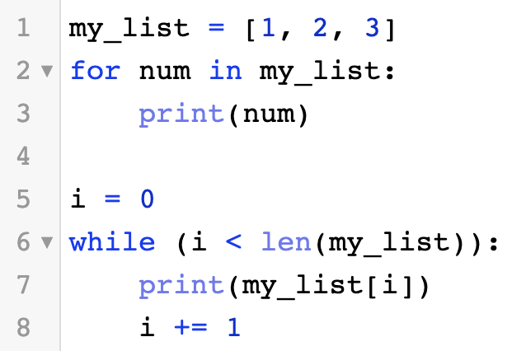
ITERATION
• Two ways to iterate through a collection:
• for loop - iterate over a specified range
• while loop - iterate while a certain condition evaluates to true

Slide 18
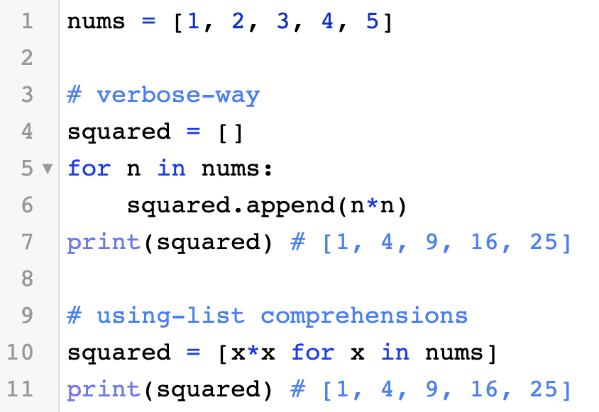
LIST COMPREHENSIONS
• An easy and concise way to create lists
• Read more about it here

Slide 19
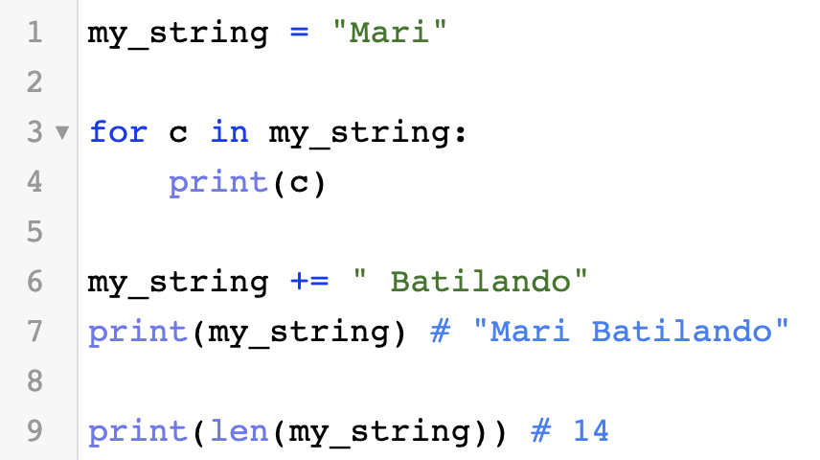
STRINGS
• Similar to a list of characters
• Can do many operations a list can: indexing, iteration
• You can use format strings for string interpolation
• Strings are immutable, so passing it in a function behaves similar to pass-by-value
• See documentation here

Slide 20
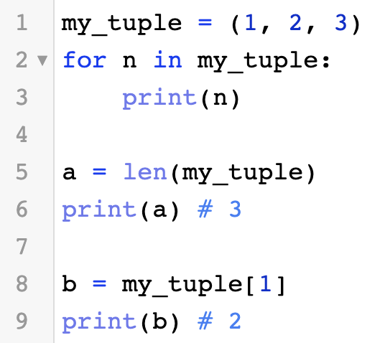
TUPLES
• Basically immutable lists
• Behavior similar to lists, but no mutable operations (e.g. append, remove, etc.)
• Passing tuples in a function behaves similar to pass-by-value
• See documentation here

Slide 21
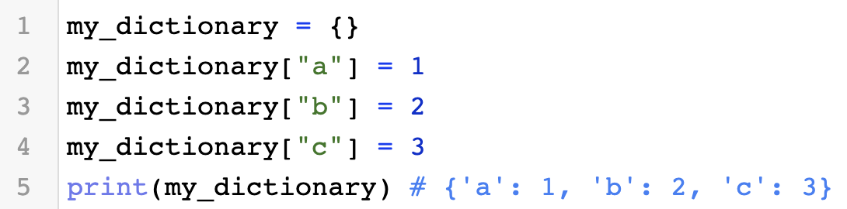
DICTIONARIES
• Stores key-value pairs
• Strings and Numbers are usually keys, though other data types can also be keys
• Value can be any data type
• Dictionaries can contain heterogeneous key-value pairs
• Dictionaries are mutable, so passing it in a function behaves similar to pass-by-reference
• Dictionaries are collections, so you can iterate through them using a for-loop
• See documentation here

Slide 22
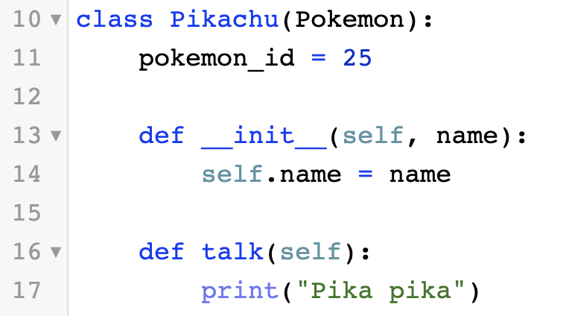
CLASSES
• Python allows creation of new types via classes
• Classes support instance and class variables/methods and they also can have inheritance
• Fun-fact: Python doesn’t support private variables/methods
• See documentation here

Slide 23
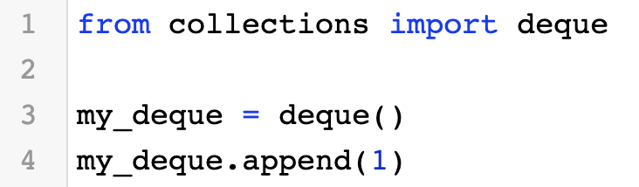
IMPORTING LIBRARIES
• Use the import keyword to import other Python libraries/modules
• Combine it with from keyword to import a specific class/variable

Slide 24
Coding Exercises
Notes:
Challenge #1
CSPT19 Lecture 1
"""
Create a function that applies a discount d to every number in the list.
Examples:
- get_discounts([2, 4, 6, 11], "50%") ➞ [1, 2, 3, 5.5]
- get_discounts([10, 20, 40, 80], "75%") ➞ [7.5, 15, 30, 60]
- get_discounts([100], "45%") ➞ [45]
Notes:
- The discount is the percentage of the original price (i.e the discount of
"75%" to 12 would be 9 as opposed to taking off 75% (making 3)).
- There won't be any awkward decimal numbers, only 0.5 to deal with.
"""
def get_discounts(nums, percentage):
discount = int(percentage[:-1]) / 100
return [n * discount for n in nums]
print(get_discounts([2, 4, 6, 11], "50%"))
"""
Create a function that takes a string, checks if it has the same number of "x"s
and "o"s and returns either True or False.
- Return a boolean value (True or False).
- The string can contain any character.
- When no x and no o are in the string, return True.
Examples:
- XO("ooxx") ➞ True
- XO("xooxx") ➞ False
- XO("ooxXm") ➞ True (Case insensitive)
- XO("zpzpzpp") ➞ True (Returns True if no x and o)
- XO("zzoo") ➞ False
"""
def XO(txt):
lower_text = txt.lower()
return lower_text.count('x') == lower_text.count('o')
"""
Create a function that returns a list of strings that are sorted alphabetically
"""
def sort_list(lst):
return sorted(lst)
Published on HackMD
31
Like Bookmark Subscribe

